Slide 1
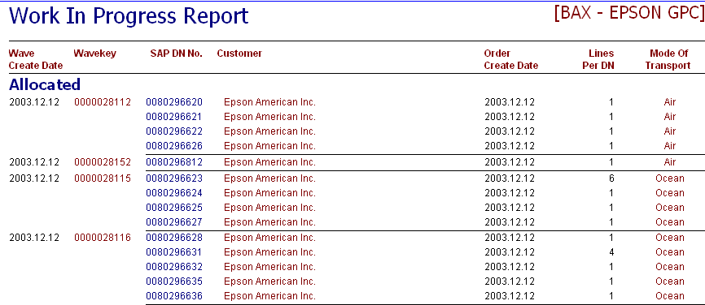
To include 2 more status:
1) Allocated
2) Picking in Progress (Based on pick list printing time)
3) Packing in Progress (Based on packing-scanning start time)
4) Packed
5) 945
ALL STATUS SHOULD BE REAL TIME INFORMATION TO USER
Replaced with a Date & Time Overview of 1)940, 2)Allocation, 3)Packed , 4)945
Date/Time format: 12.13~16
12 rep Month
13 rep Date
16 rep Time (4pm)

